Slide 1
FINAL INTERNSHIP PROJECT REPORT
Job Skill Extraction and Normalization Using NLP and Machine Learning

Slide 2
Introduction
Job descriptions contain important information about roles, qualifications and technical requirements. Manual identification of skills is time-consuming and can be inconsistent. This project applies Natural Language Processing (NLP) to automatically identify technical skills from job descriptions and organize them into meaningful categories.
The project follows a progressive workflow from data understanding and cleaning to rule-based extraction, statistical NLP, semantic techniques, machine learning, normalization, analytics and application development.

Slide 3
Project Scope & Use Case
Recruitment and job-market analytics
Skill demand analysis by job role and location
Skill taxonomy and normalization
Foundation for resume-job matching and skill-gap analysis
Educational demonstration of NLP extraction techniques

Slide 4
Technology & Tools Used
Technology | Purpose
Python | Core implementation
Pandas / NumPy | Data handling and analysis
NLTK / spaCy | NLP preprocessing and NER exploration
Scikit-learn | TF-IDF and ML classification
Transformers / Sentence Transformers | Advanced semantic and transformer methods
Matplotlib / Seaborn | EDA visualizations
Power BI / Tableau | Dashboard layer
Streamlit / FastAPI | Application/API layer

Slide 5
System Architecture & Methodology
Stage | Output
Dataset collection | raw_jobs.csv
Cleaning | clean_description
Skill taxonomy | master skill dictionary
Extraction | detected skills
Normalization | canonical skill names
Analytics | skill-demand outputs
Application | Streamlit interface

Slide 6
Dataset Collection & Understanding
The supplied dataset contains 100 records and 10 columns. The main text field for extraction is job_description. The other fields provide role, company, location, experience, education, salary, job type and a required skill reference
Field | Description
job_id | Unique job identifier
job_title | Job role/title
company | Hiring company
location | Job location
job_description | Unstructured text used for NLP
experience | Required experience
education | Education requirement
salary_lpa | Salary in LPA
job_type | Employment type
required_skills | Provided skill list used for validation
gt_skills | Dataset field
rule_skills | Dataset field
regex_skills | Dataset field
clean_description | Dataset field
description_length | Dataset field

Slide 7
Exploratory Data Analysis (EDA)
The dataset contains 100 jobs, 15 unique job titles and 12 unique locations. Average description length is 409.3 characters, minimum 380, maximum 440. Average salary is 7.74 LPA.
Measure | Result
Total jobs | 100
Unique job titles | 15
Unique locations | 12
Average description length | 409.3 characters
Minimum description length | 380
Maximum description length | 440
Missing values | 0
Duplicate rows | 0
Average salary | 7.74 LPA

Slide 8
Top job titles:
Job Title | Count
Java Developer | 12
Data Engineer | 11
Data Analyst | 9
DevOps Engineer | 8
Business Analyst | 8
AI Engineer | 7
Web Developer | 7
SQL Developer | 7
Power BI Developer | 6
Software Engineer | 6
Top locations:
Location | Count
Mumbai, Maharashtra | 13
Remote, India | 11
Gurugram, Haryana | 11
Nagpur, Maharashtra | 10
Ahmedabad, Gujarat | 10
Chennai, Tamil Nadu | 8
Noida, Uttar Pradesh | 8
Bengaluru, Karnataka | 8
Pune, Maharashtra | 6
Nashik, Maharashtra | 6

Slide 9
Skill Taxonomy Development
Category | Example Skills
Programming | Python, Java, C++, JavaScript, TypeScript, C#, Go, PHP...
Database | SQL, MySQL, PostgreSQL, MongoDB, Oracle, SQLite
Analytics/BI | Power BI, Tableau, Excel, Data Analysis, Statistics
Machine Learning | Scikit-learn, TensorFlow, PyTorch, Machine Learning, Deep Learning, NLP, LLM, Computer Vision
Cloud | AWS, Azure, GCP, Google Cloud
Big Data | Spark, Hadoop, Kafka
DevOps/Tools | Docker, Kubernetes, Git, Jenkins, REST API, Microservices, Spring Boot, Hibernate

Slide 10
Statistical & Semantic NLP Techniques
TF-IDF identifies terms that are important across job descriptions. N-Grams capture multi-word skills such as Machine Learning, Power BI and Natural Language Processing.
Top TF-IDF Term | Mean TF-IDF
experience | 0.0995
business | 0.0549
sql | 0.0529
solutions | 0.0498
candidate | 0.0498
communicate | 0.0498
technical problems | 0.0498
solutions solve | 0.0498
technical | 0.0498
business requirements | 0.0498

Slide 11
Named Entity Recognition (NER)
spaCy NER is used to study standard entity recognition and its limitations for technical skills. Standard NER models may recognize general entities such as organizations and locations but are not guaranteed to recognize domain-specific technical skills.
A custom SKILL entity approach can be built using the project's taxonomy and phrase matching, which is better aligned with recruitment skill extraction.

Slide 12
Machine Learning Model
A supervised skill-category classifier was built using TF-IDF features and Logistic Regression. Training examples consist of canonical skill names and available aliases mapped to taxonomy categories.
Metric | Result
Accuracy | 0.400
Weighted Precision | 0.317
Weighted Recall | 0.400
Weighted F1 | 0.302

Slide 13
Model Evaluation & Comparison
Precision, recall and F1 are emphasized for extraction because the goal is to identify relevant skill entities accurately.
Method | Precision | Recall | F1
Dictionary Matching | 0.980 | 0.741 | 0.844
Regex + Phrase Matching | 0.980 | 0.741 | 0.844
TF-IDF | Keyword analysis | Keyword analysis | N/A
NER | Requires labeled spans | Requires labeled spans | Requires labeled spans
ML Category Classifier | 0.317 | 0.400 | 0.302
Transformer | Requires labeled evaluation | Requires labeled evaluation | Requires labeled evaluation
The supplied required_skills field is used as a reference list for extraction evaluation. A stronger research-grade NER evaluation would use manually annotated character-level skill spans.

Slide 14
Skill Normalization & Categorization
Normalization converts raw skill text into canonical names using lowercase conversion, special-character handling and alias matching, followed by category mapping.
Raw Skill | Canonical Skill | Category
python3 | Python | Programming
python 3 | Python | Programming
python programming | Python | Programming
powerbi | Power BI | Analytics/BI
power-bi | Power BI | Analytics/BI
ms excel | Excel | Analytics/BI
postgres | PostgreSQL | Database
postgresql | PostgreSQL | Database
ml | Machine Learning | Machine Learning
machine learning | Machine Learning | Machine Learning
nlp | NLP | Machine Learning
natural language processing | NLP | Machine Learning

Slide 15
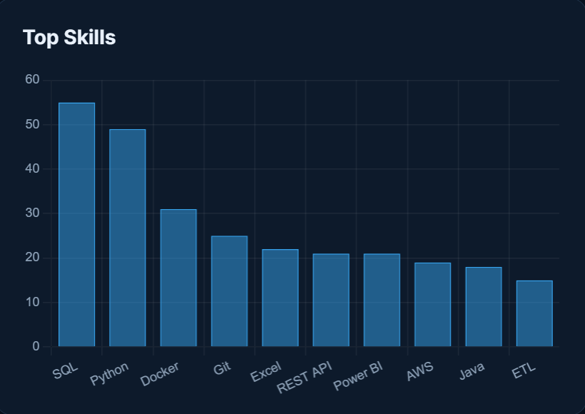
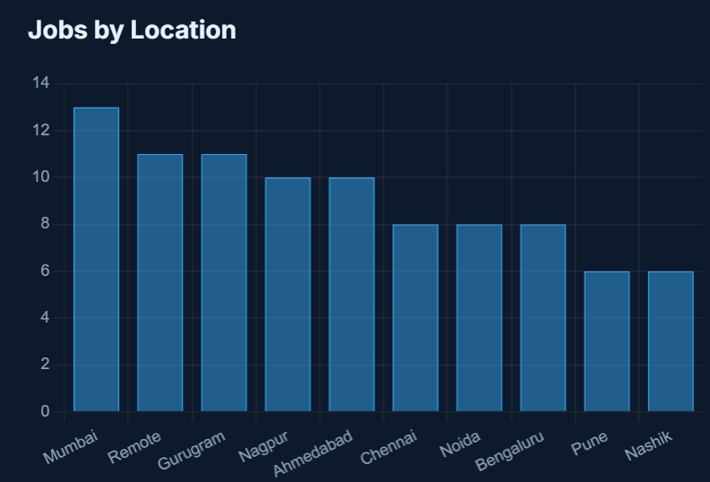
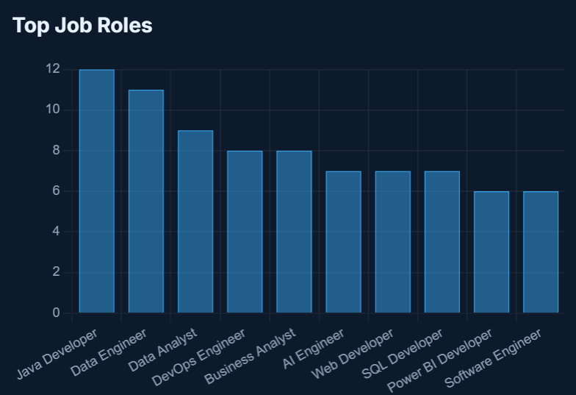
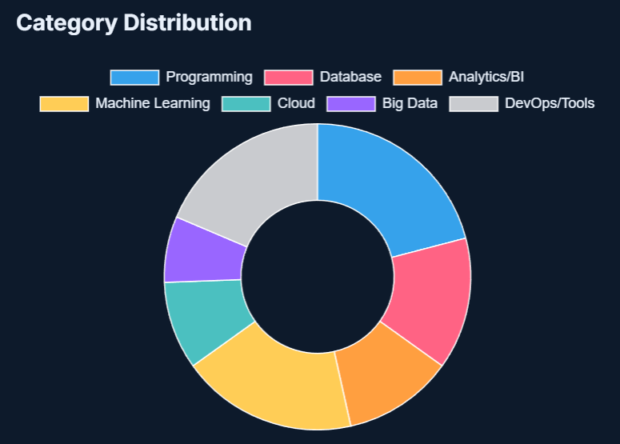
Dashboard & Data Visualization

Slide 16
Application / API Development
A Streamlit application is included in app.py. Users paste a job description and receive detected skills and category mappings.
Architecture: User → Web Interface → Preprocessing → Skill Extraction → Normalization → Category Mapping → Final Skills.
FastAPI can expose the same pipeline through a REST API when deployment requires an API layer.

Slide 17
Testing & Results
Test Case | Input | Observed Result
TC01 | Python and SQL required | Python, SQL detected
TC02 | Looking for Data Analyst with SQL, Python, Power BI and Excel experience. | Power BI, Python, Excel, SQL
TC03 | Python3 and Power-BI | Python / Power BI handled by normalization-aware rules
TC04 | Cloud technologies | No specific cloud provider inferred unless named
Overall dataset results: 100 records processed, 0 missing values, 0 duplicate rows. Extraction and ML metrics are reported above from actual calculations.

Slide 18
Challenges & Limitations
Technical skills have many aliases and spelling variations.
Standard NER may miss technical skills.
Dictionary methods cannot automatically discover unseen skills.
Generic words may create false positives.
Transformer methods require labeled data and pretrained resources.
Future Scope
Resume-job matching
Candidate ranking
Skill-gap analysis
Recommendation system
Fine-tuned transformer NER using manually labeled entities
Continuous skill-taxonomy updates
FastAPI and cloud deployment

Slide 19
Learning Outcomes
Real-world NLP workflow
Dataset inspection and EDA
Text cleaning and preprocessing
Skill taxonomy and normalization
TF-IDF and N-Gram analysis
Regex and rule-based extraction
Supervised ML with TF-IDF
Conclusion
The project demonstrates an end-to-end NLP workflow for extracting technical skills from job descriptions. It combines data analysis, cleaning, taxonomy development, rule-based and regex extraction, statistical NLP, supervised categorization, normalization and a user-facing application. The calculated results provide a reproducible baseline and the semantic/transformer components provide a path toward more context-aware extraction.

Slide 20
References
Python Documentation
Pandas Documentation
NumPy Documentation
NLTK Documentation
spacy Documentation
Scikit-learn Documentation
Power BI Documentation
Streamlit Documentation, if used
FastAPI Documentation, if used
Dataset source used for the project

